Slide 1

Project Presentation
August Delbert
Max Chis

Slide 2
A Database For All Your Useless Products!
Our company produces only inventions that have no utility whatsoever! The names and descriptions were made via online random word generators.
Despite this, we somehow have a thriving company of employees, customers, and administrators, all of whom require a database to organize and access company-relevant information.

Slide 3
Assumptions
Single database that can be access via multiple portals unique to different types of users, including:
Customers seeking information on products they have purchased and cases related to those products
Salespeople seeking information on customer’s contact information
Executives/business intelligence systems analysts seeking information onnumber of products sold and queries grossed

Slide 4
Types of users accessing database
Potential and existing customers
Salespersons
Database Administrators
Support employees
IT professionals
Executives

Slide 5
Assumptions
A variety of relationships exist between different tables; some one-to-one, others one-to-many or many-to-many.
For example: the relationship between salespersons and products is many-to-many: salespersons can sell multiple products, and the same product can be sold by multiple salespeople.

Slide 6
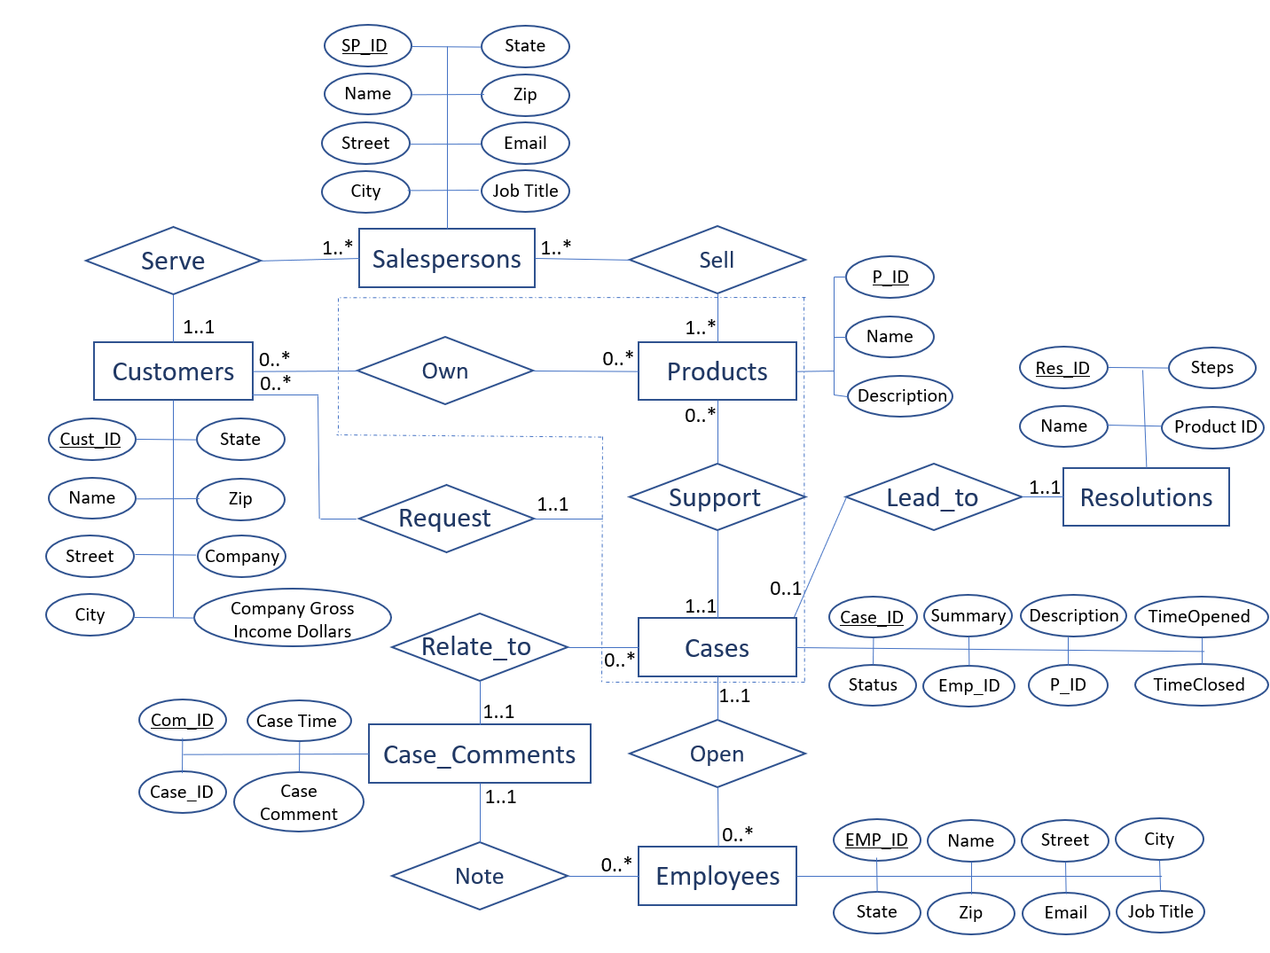
Graphical Schema

Slide 7
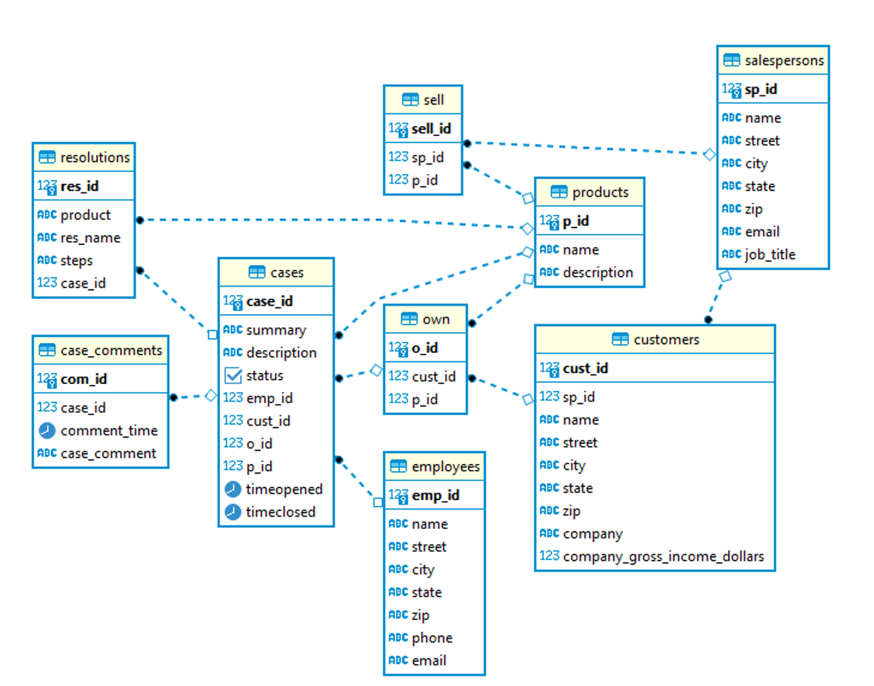
Relational Schema Set

Slide 8
Design Limitations
Information about Gross income of a customer’s company currently aggregated into a single amount, with no way to see how much is spent on different products
Limited ability to track resolutions (i.e., cannot track resolutions by common cause or solution)
No means of accounting for former (as opposed to current) customers, or for when customers stop using a given product.

